Slide 1
State pattern
Designed by: Huong thi diem truong

Slide 2
Content
Problem
Resolution
Game Mario

Slide 3
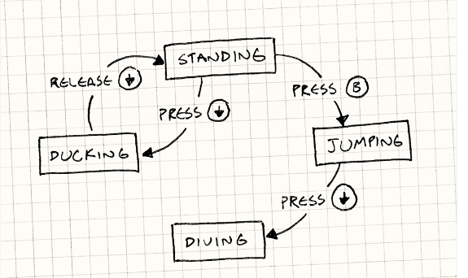
problem

Slide 4
Resolution
Condition statement (If/else)
Simple
Not clearly
Enum
(Switch - cases)
Simple but improving
Break some Principles of Object Oriented Design
State pattern
Encapsulate state become class
If game has many objects with different states -> difficult to manage

Slide 5
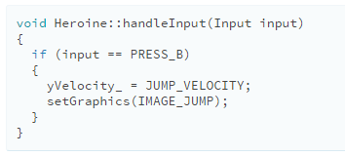
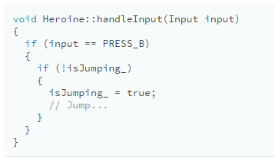
Conditional Statement (if – else)

Slide 6
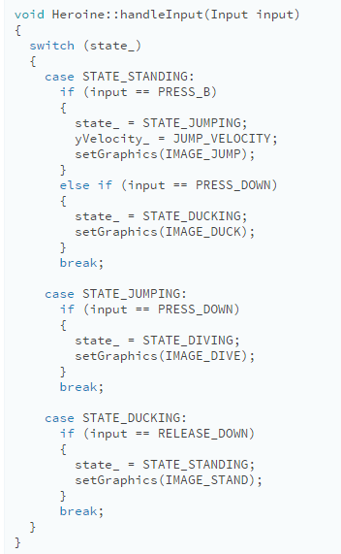
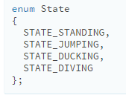
Enum (switch - cases)

Slide 7
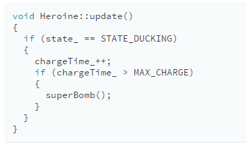
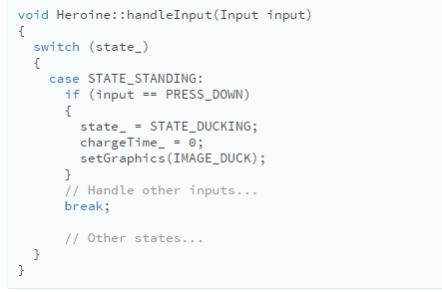
Enum (switch - cases)

Slide 8
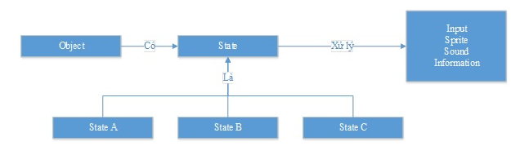
State pattern

Slide 9
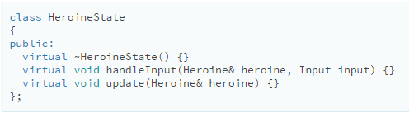
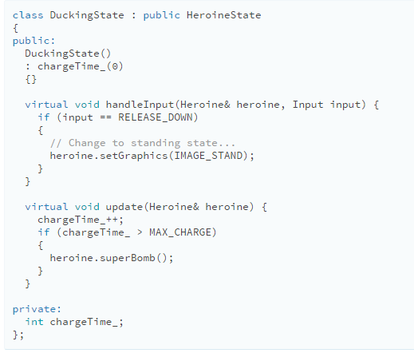
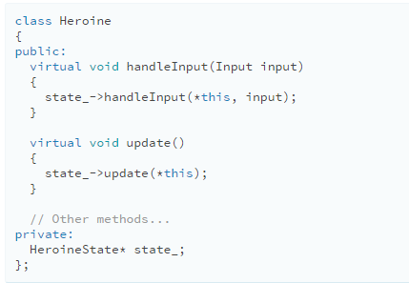
State pattern – implement

Slide 10
Mario game - State

Slide 11
Mario game – class diagram

Slide 12
Thank you

